Slide 1
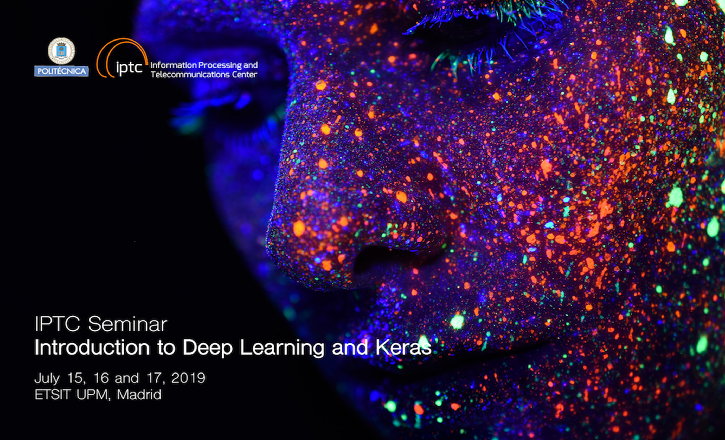

Slide 2
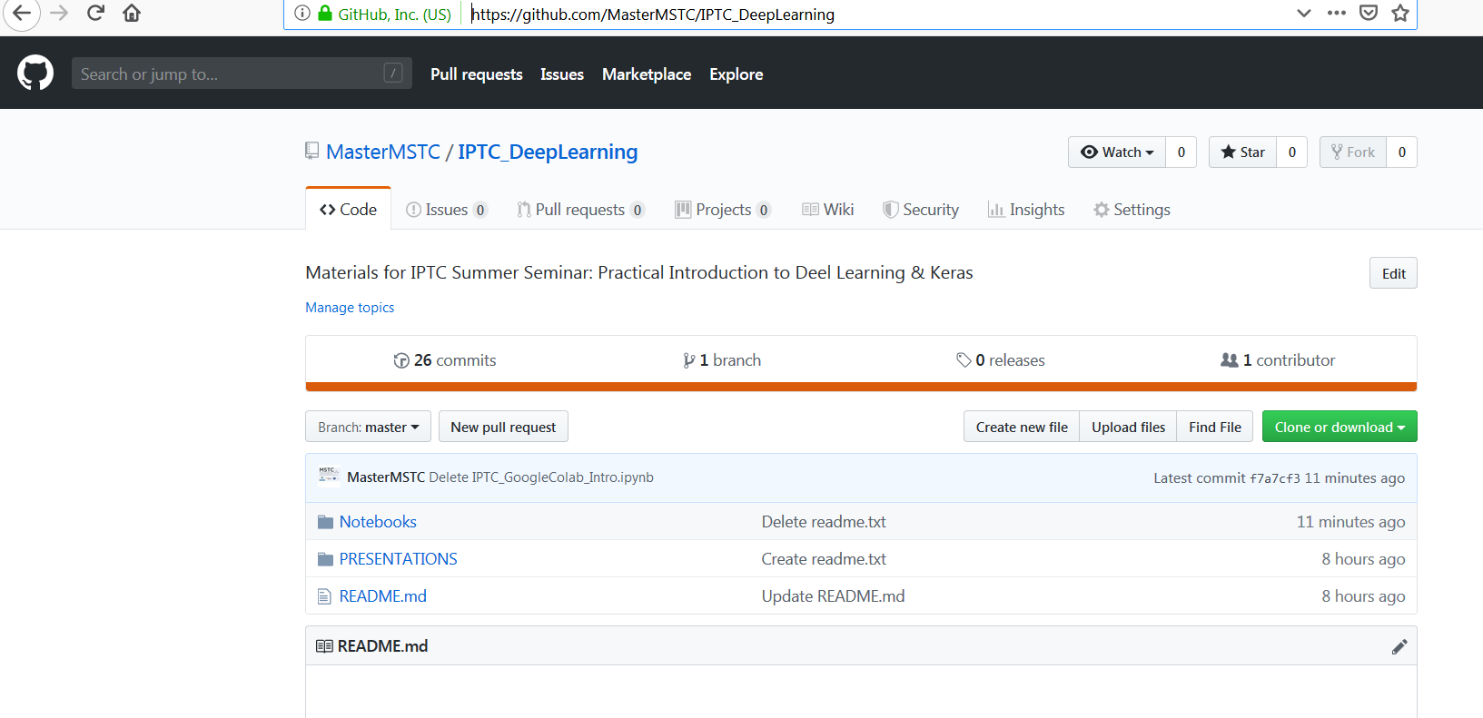
IPTC Summer Seminar MATERIALS
Please go to our MSTC GitHub:
https://github.com/MasterMSTC/IPTC_DeepLearning

Slide 3
Introduction to Deep Learning & Keras Day 3
Prof. Luis A. Hernández Gómez
luisalfonso.hernandez@upm.es

Slide 4
Day 1 (July 15) : Intro to Deep Learning & Keras.
Feed Forward models
Day 2 (July 16) : Backpropagation. Convolutional Networks
Transfer Learning. Data Augmentation.
Day 3 (July 17) : Recurrent Networks. Advanced Architectures.
GANs. Applications. Final discussion on AI

Slide 5
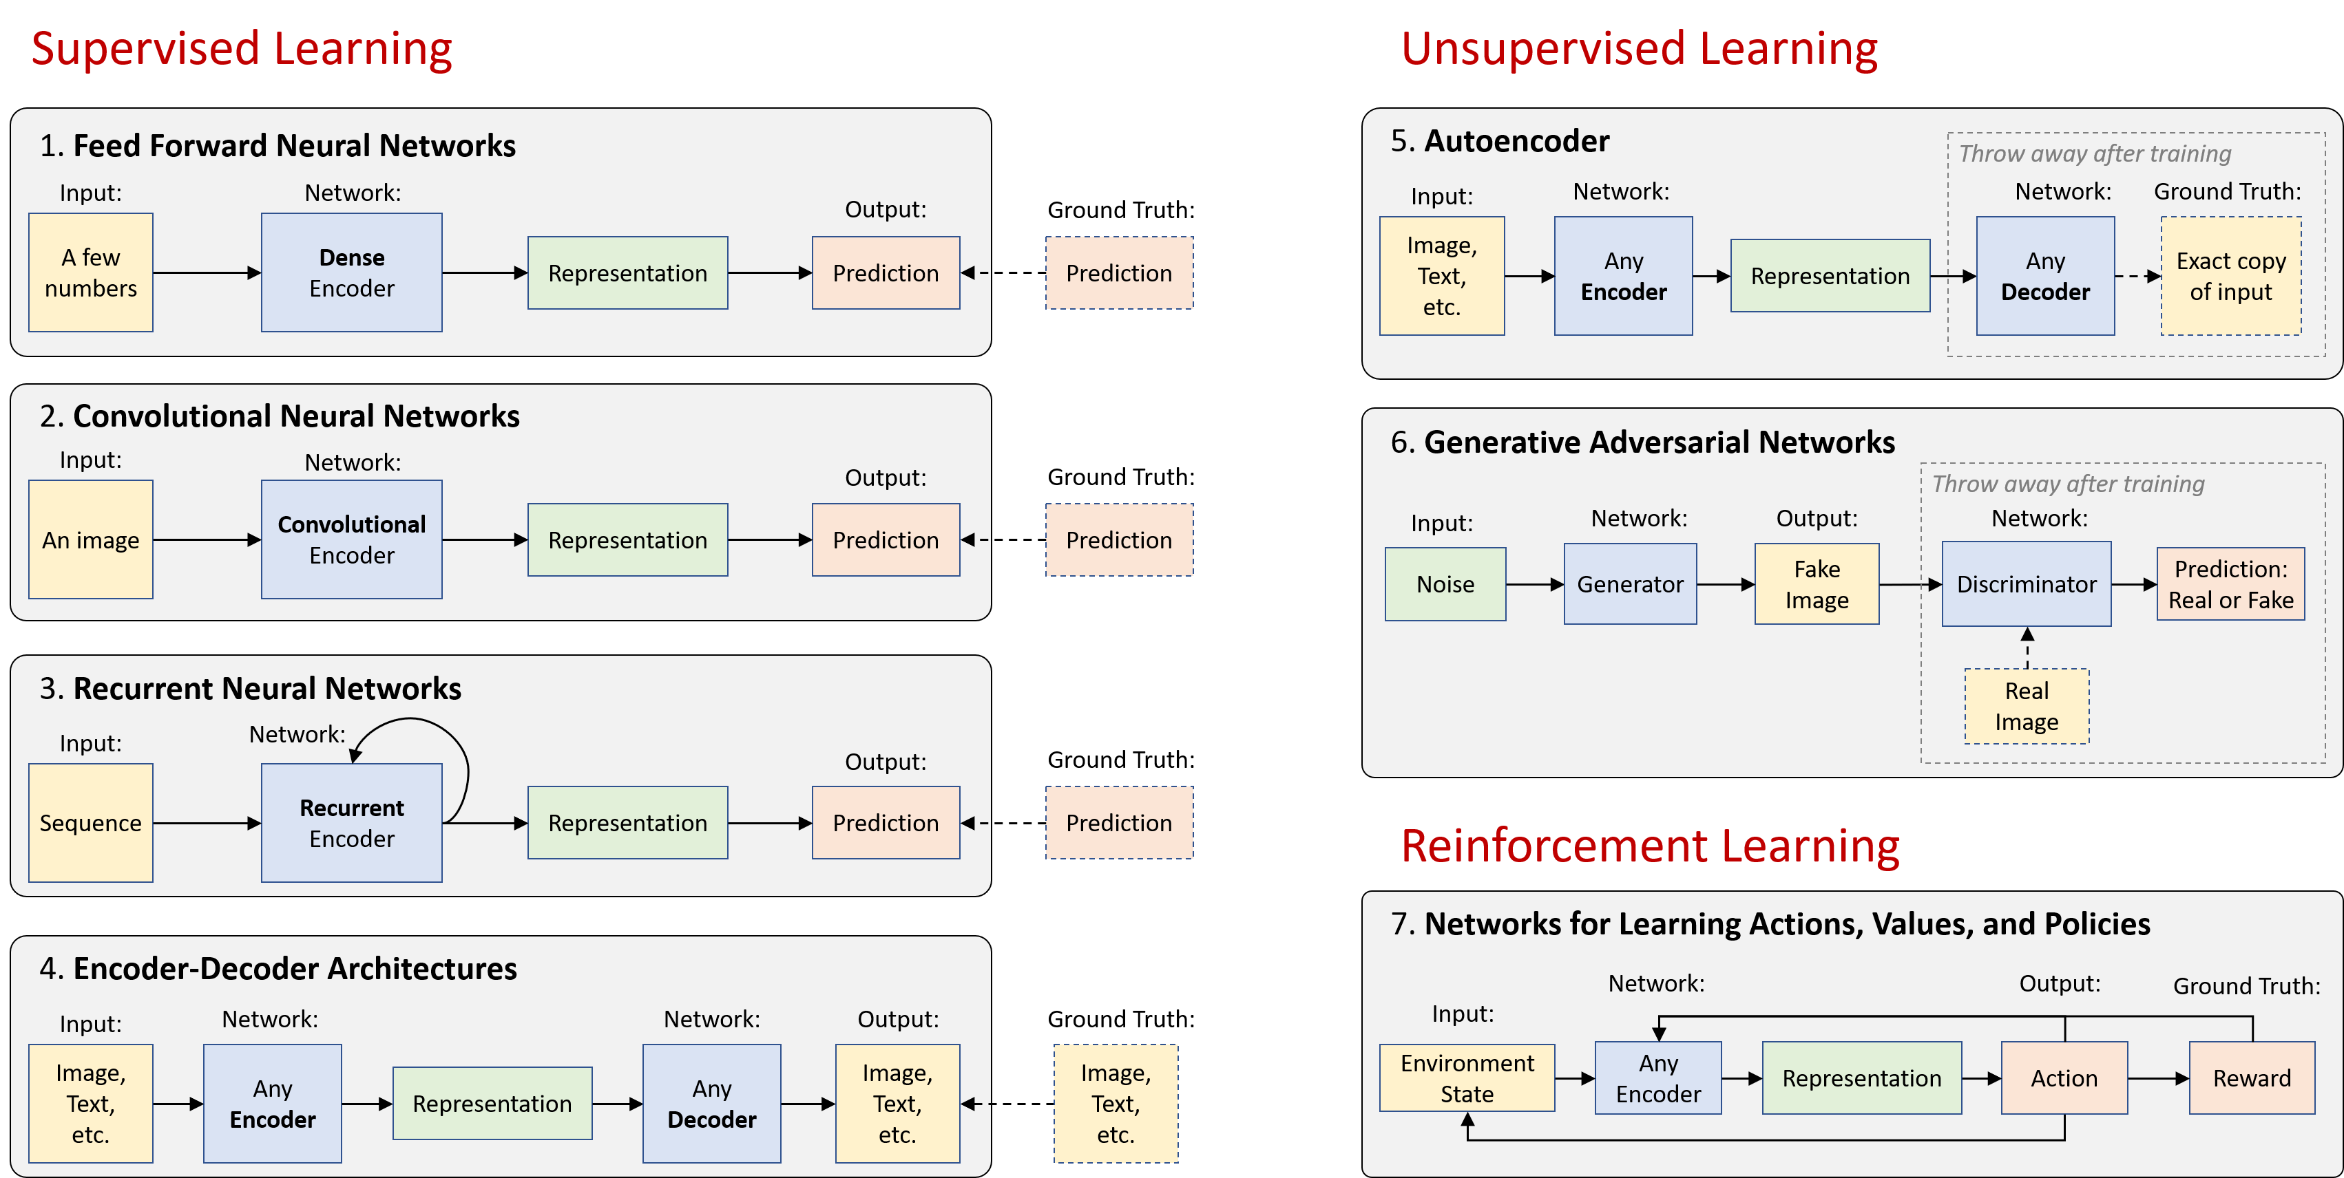
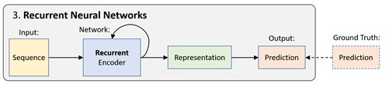
Deep learning basics
…. will also introduce Generative Models
https://github.com/lexfridman/mit-deep-learning/blob/master/tutorial_deep_learning_basics/deep_learning_basics.ipynb

Slide 6
Modelling sequences
Applications areas are broad:
Signals: video, speech, music, sensors,….
Time series: financial series, log messages,..
Sequence of characters: Natural Language Processing, MIDI music…
Sequences of observations, actions, rewards: Reinforcement Learning (robots, bots, autonomous vehicles, dialog systems..)

Slide 7
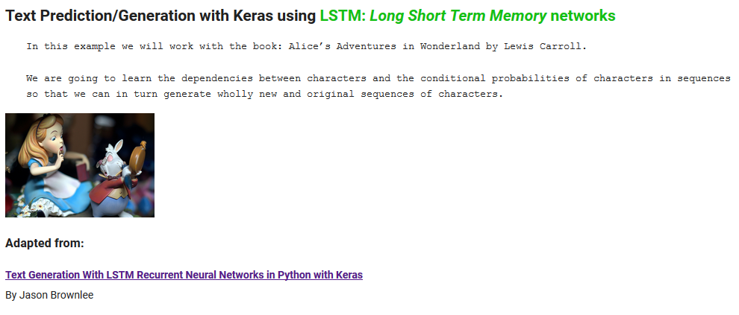

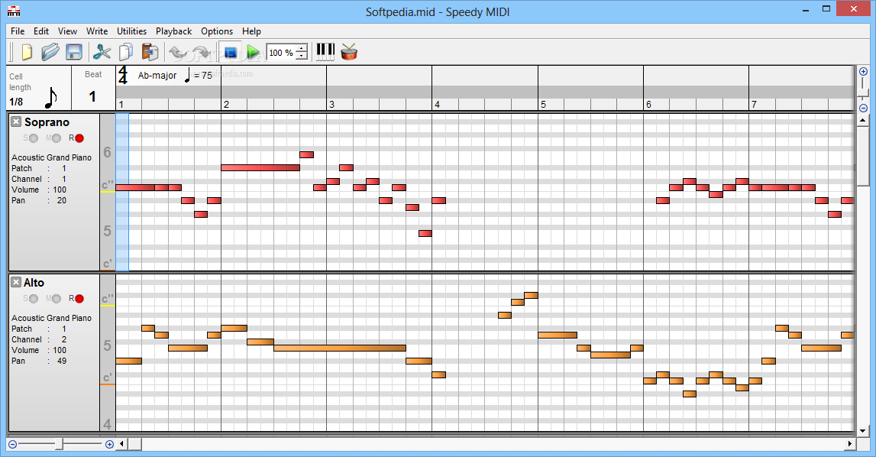
Simple Examples: NLP & MUSIC
MIDI Music Generation

Slide 8
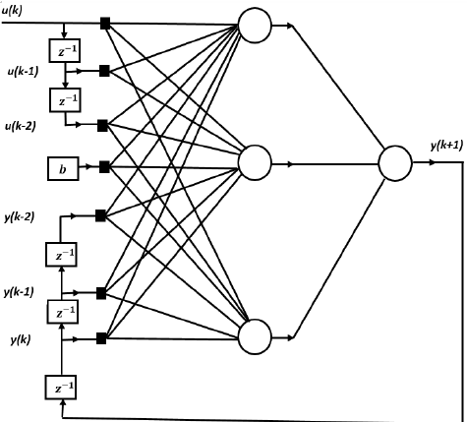
Memoryless models for sequences
NARX model: Nonlinear Auto Regressive Model with external inputs.
Another name: TDNN (time-delay neural network)

Slide 9

WaveNet models the conditional probability distribution $p\left(x_{t} | x_{1},…,x_{t−1}\right)$ with a stack of dilated causal convolutions.
Output
dilation = 8
Hidden layer
dilation = 4
Hidden layer
dilation = 2
Hidden layer
dilation = 1
Input
https://deepmind.com/blog/wavenet-generative-model-raw-audio/

Slide 10
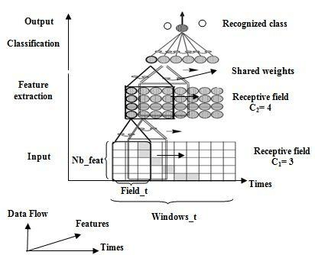
TDNN : Time Delay Neural Network
Peddinti, Vijayaditya, Daniel Povey, and Sanjeev Khudanpur. "A time delay neural network architecture for efficient modeling of long temporal contexts." Sixteenth Annual Conference of the International Speech Communication Association. 2015.
Ferrat, Kamel, and Mhania Guerti. "Classification of the Arabic emphatic consonants using time delay neural network." International Journal of Computer Applications 80.10 (2013).

Slide 11
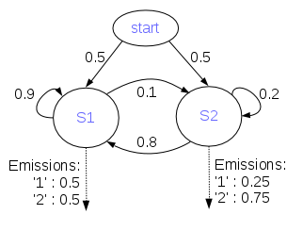
Dynamic Generative Models: as for example Hidden Markov Models
Hidden Markov Models have a discrete one-of-N hidden state.
Transitions between states are stochastic and controlled by a transition matrix.
The outputs produced by a state are stochastic.
A fundamental limitation of HMMs
Consider what happens when a hidden Markov model generates data.
At each time step it must select one of its hidden states.
So with N hidden states it can only remember log(N) bits about what it generated so far.
From: Geoffrey Hinton
CSC2535 2013: Advanced Machine Learning

Slide 12
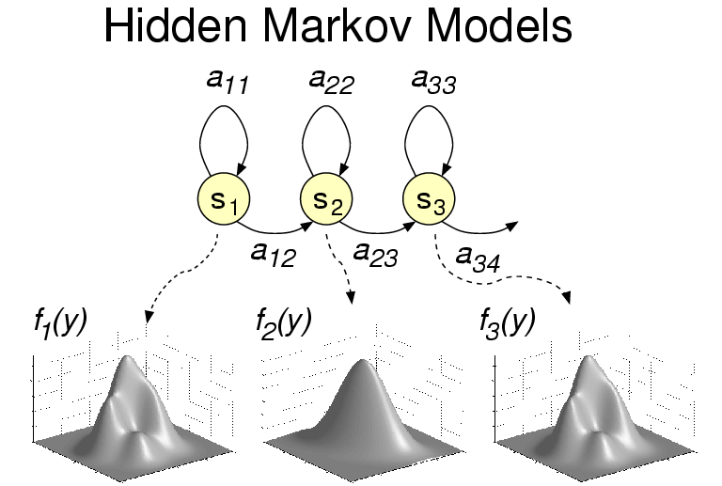
Traditional Automatic Speech Recognition : HMMs

Slide 13
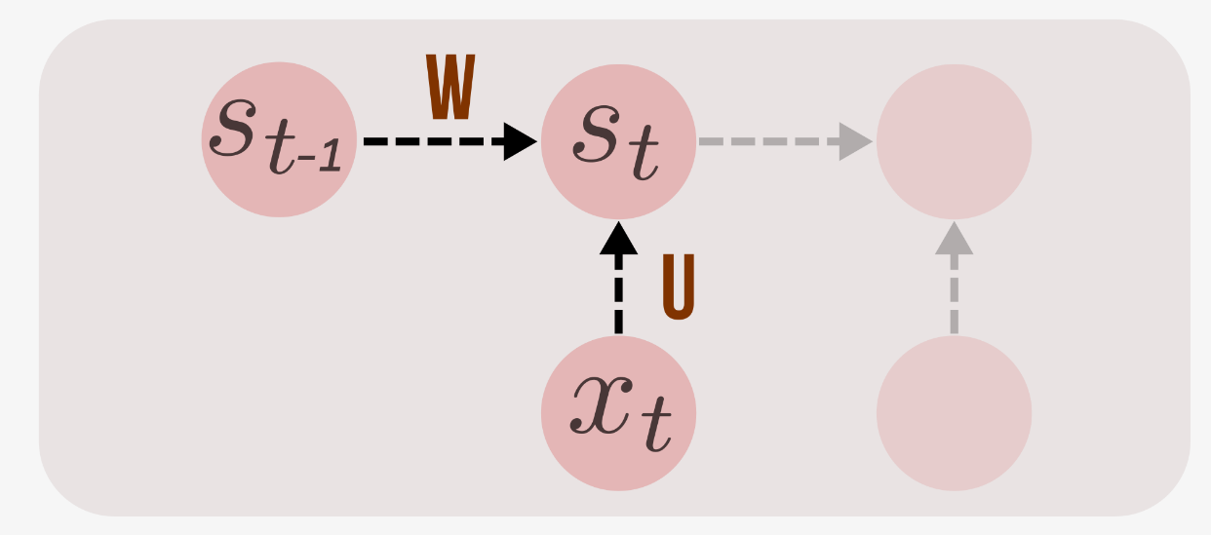
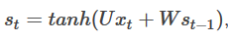
Recurrent Neural Networks (RNN)
RNNs combine the input vector with their state vector with a fixed (but learned) function to produce a new state vector.
http://suriyadeepan.github.io/2017-02-13-unfolding-rnn-2/

Slide 14
Recurrent Neural Networks (RNN)
RNNs are very powerful, because they combine two properties:
Distributed hidden state that allows them to store a lot of information about the past efficiently.
Non-linear dynamics that allows them to update their hidden state in complicated ways.
With enough neurons and time, RNNs can compute anything that can be computed by your computer.
From: Geoffrey Hinton
CSC2535 2013: Advanced Machine Learning

Slide 15
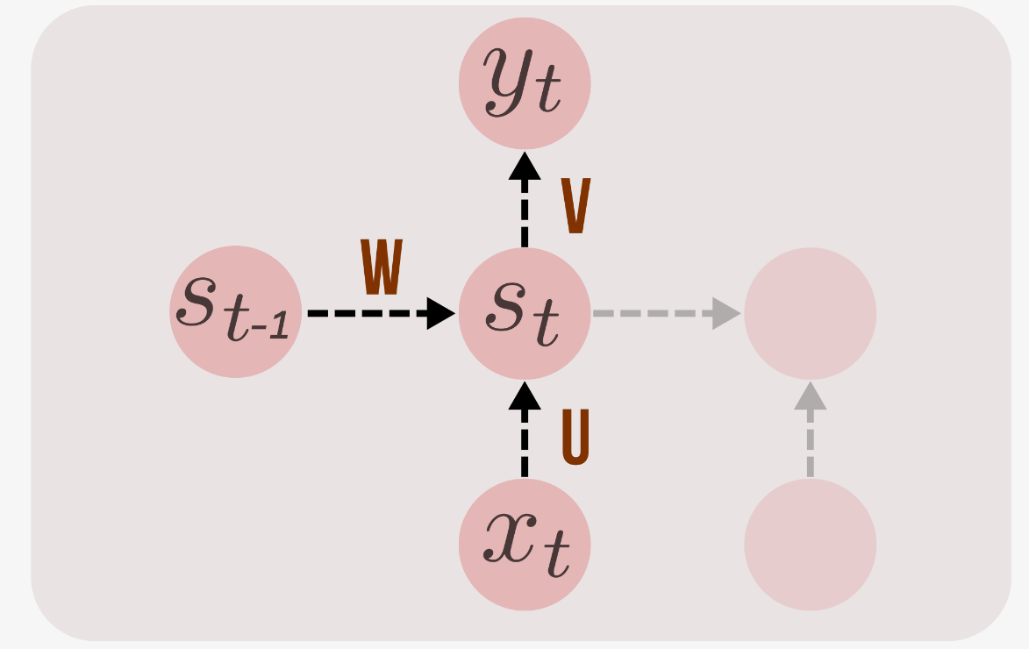
OUTPUT $y_{t}$
logits = tf.matmul(state, V) + b
predictions = tf.nn.softmax(logits)

Slide 16
RNN essentially describe programs:
inputs + some internal variables.
In fact, it is known that RNNs are Turing-Complete in the sense that they can to simulate arbitrary programs (with proper weights).

Slide 17
Neural Turing Machines
Can neural nets learn programs?
Alex Graves
Greg Wayne
Ivo Danihelka

Slide 18
…path to AI??
…. But “ forget I said anything.”
Andrej Karpathy
http://karpathy.github.io/2015/05/21/rnn-effectiveness

Slide 19

Recurrent Neural Networks Applications
Image
description
using text
Emotion
Recognition
Language
Model
Machine
Translation
Video frame
labelling
Phoneme
Recognition

Slide 20
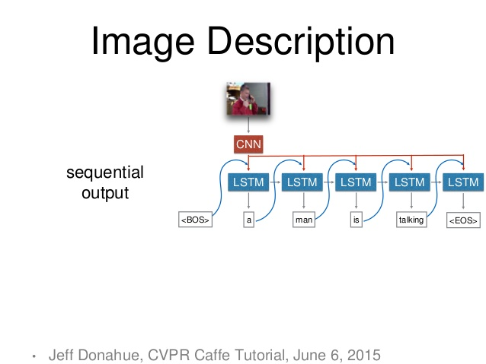

Slide 21
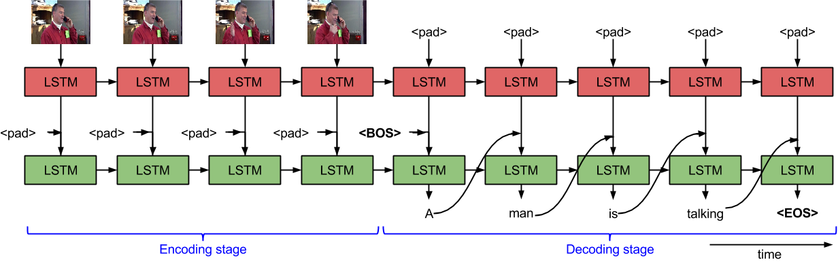
Sequence to Sequence - Video to Text Subhashini Venugopalan, et al.

Slide 22
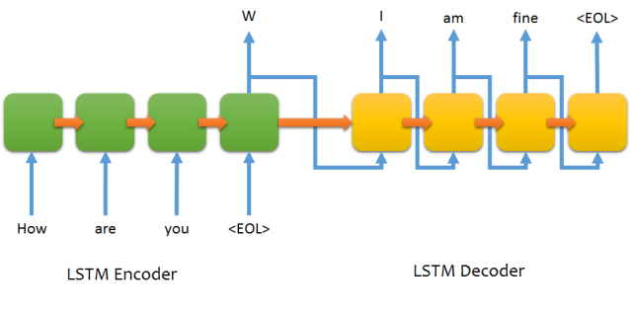
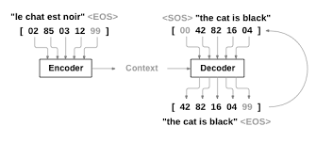
Machine translation, chatbots

Slide 23
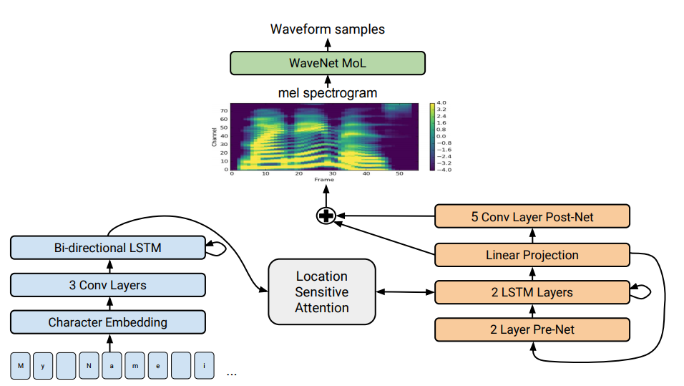
END-TO-END Text-to-Speech
Tacotron 2: Generating Human-like Speech from Text
https://ai.googleblog.com/2017/12/tacotron-2-generating-human-like-speech.html

Slide 24
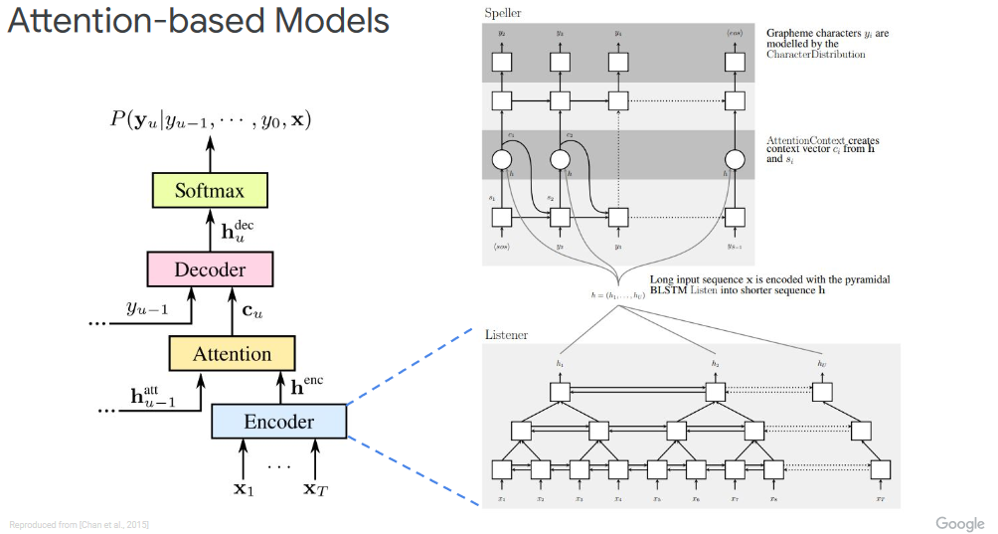
END-TO-END Automatic Speech Recognition
http://iscslp2018.org/images/T4_Towards%20end-to-end%20speech%20recognition.pdf

Slide 25
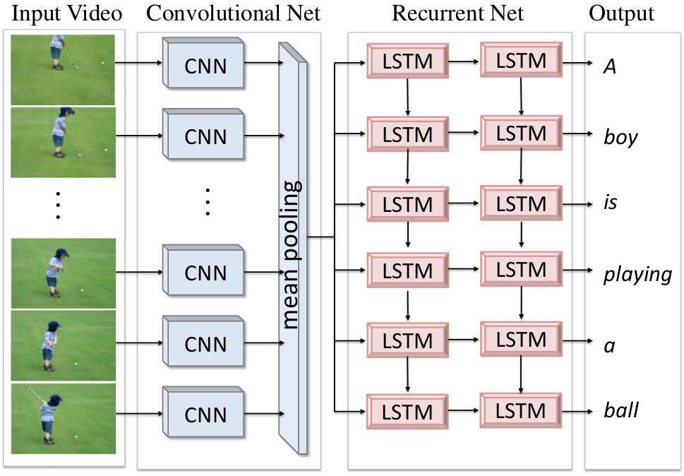
Translating Videos to Natural Language Using Deep Recurrent Neural Networks Subhashini Venugopalan, et al.

Slide 26
Written Memories: Understanding, Deriving and Extending the LSTM
http://r2rt.com/written-memories-understanding-deriving-and-extending-the-lstm.html

Slide 27
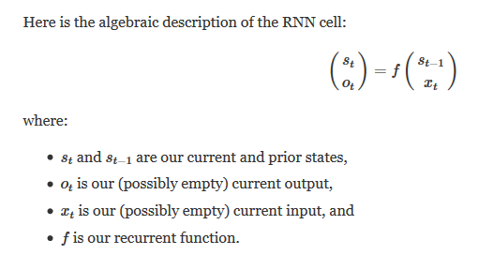

Slide 28
$${ y}_{}$$
$${y_{t−1}{ y}_{t} y}_{t+1}$$

Slide 29
Output sequence
$${y_{t−1}{ y}_{t} y}_{t+1}………$$
Input sequence
$${x_{t−1}{ x}_{t} x}_{t+1}………$$

Slide 30
……
State
sequence!
$${s_{t−1}{ s}_{t} s}_{t+1}………$$

Slide 31
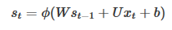
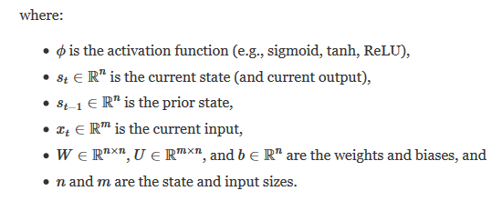
$${{ y}_{t}}_{}$$
$${{ s}_{t}}_{}$$
$${{ s}_{t−1}}_{}$$
$${{ x}_{t}}_{}$$

Slide 32
TRAINING RNN: W, U, V ?
BPTT: Backpropagation Through Time
Truncated

Slide 33
Backpropagation Through Time (BPTT)
Because the parameters are shared by all time steps in the network
The gradient at each output depends not only on the calculations of the current time step, but also the previous time steps.
http://www.wildml.com/2015/09/recurrent-neural-networks-tutorial-part-2-implementing-a-language-model-rnn-with-python-numpy-and-theano/

Slide 34
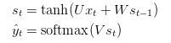
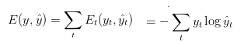

Backpropagation Through Time (BPTT)
Cross entropy loss:
The output value does depend on the state of the hidden layer,
which depends on all previous states of the hidden layer
and thus, all previous inputs

Slide 35
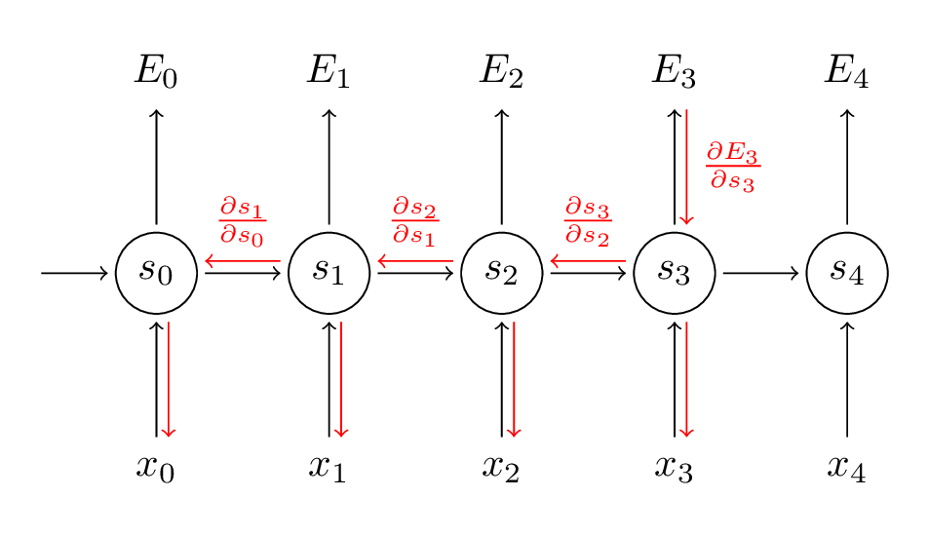
Backpropagation Through Time (BPTT)
But the recurrent net can be seen as a (very deep) feedforward net with shared weights
The forward pass builds up a stack of the activities of all the units at each time step.
The backward pass peels activities off the stack to compute the error derivatives at each time step.
After the backward pass we add together the derivatives at all the different times for each weight
$$\frac{∂E_{t}}{∂W}=\sum_{k=0}^{t}{\frac{∂E_{t}}{∂y_{y}}\frac{∂y_{t}}{∂s_{t}}\frac{∂s_{t}}{∂s_{k}}\frac{∂s_{k}}{∂W}}$$

Slide 36
Styles of Truncated Backpropagation
Tensorflow-style
num_steps

Slide 37
Vanishing gradient problem
In an RNN trained on long sequences (e.g. 100 time steps) the gradients can easily explode or vanish.
Led to the development of LSTMs and GRUs, two of the currently most popular and powerful models
http://www.wildml.com/2015/09/recurrent-neural-networks-tutorial-part-2-implementing-a-language-model-rnn-with-python-numpy-and-theano/

Slide 38
You can see a simple NLP task
Predicting Text Characters
https://github.com/MasterMSTC/DeepLearning_TF_Keras
MSTC_Keras_RNN_2_Text.ipynb

Slide 39
Text prediction & generation using RNN

Slide 40
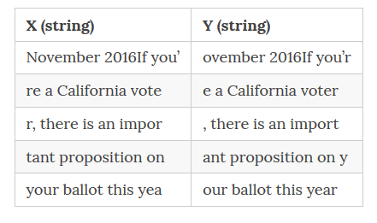
The NLP Task: language modeling to capture the statistical relationship among words / chars
The objective of the network is to observe the input x, one character at a time and produce the output sentence y, one character at a time
http://suriyadeepan.github.io/2017-02-13-unfolding-rnn-2/

Slide 41
Output sequence
……
$${y_{t−1}{ y}_{t} y}_{t+1}………$$
Input sequence
……
$${x_{t−1}{ x}_{t} x}_{t+1}………$$

Slide 42
Now we can test using LSTM or GRU
+ much more to consider…
#Dropout
# Regularization
# Batch normalization
# Adding noise…

Slide 43
RNN are Generative Models
Vanilla (Elman), LSTM or GRU can be used to generate TEXT

Slide 44
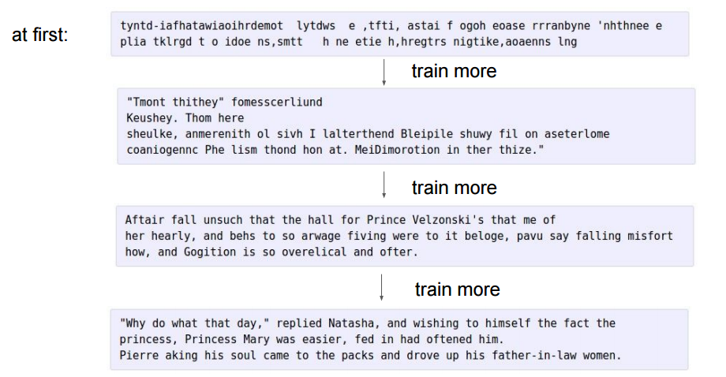
100 th
iteration
300 th
iteration
700 th
iteration
2000 th
iteration
Andrej Karpathy, Blog on “Unreasonable Effectiveness of Recurrent Neural Networks”

Slide 45
Basic concepts: LSTM & GRU
http://colah.github.io/posts/2015-08-Understanding-LSTMs/
Vanishing gradients: a problem?
it may be that for some tasks we want gradients to vanish completely, and for others, it may be that we want them to grow
Are RNNs capable of handling “long-term dependencies?”
Long Short Term Memory networks – LSTMs
Hocreiter and Schmidhuber (1997)

Slide 46
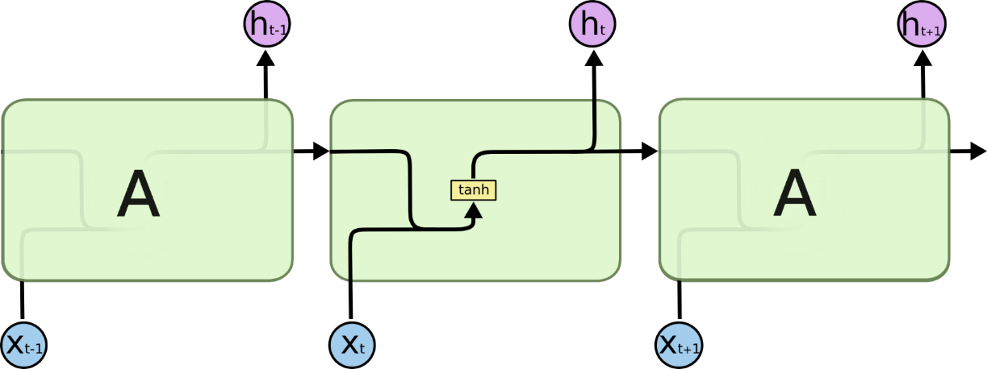
$$NOTATION: states= h_{t}$$
The repeating module in a standard RNN contains a single layer

Slide 47

The repeating module in LSTM contains four interacting layers

Slide 48


Core Idea Behind LSTM
CELL STATE $= c_{t}$
$$states= h_{t}$$

Slide 49
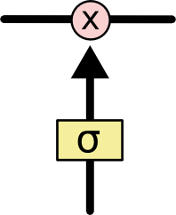
Core Idea Behind LSTM
The LSTM does have the ability to remove or add information to the cell state, carefully regulated by structures called gates.
Gates are a way to optionally let information through.
They are composed out of a sigmoid neural net layer and a pointwise multiplication operation.
A value of zero means “let nothing through,” while a value of one means “let everything through!”
An LSTM has three of these gates, to protect and control the cell state

Slide 50
Basic concepts: LSTM & GRU
Hocreiter and Schmidhuber (1997)
The fundamental principle of LSTMs: to ensure the integrity of our messages in the real world, we write them down
The fundamental challenge of LSTMs and keeping our state under control is to be selective in three things:
what we write (write selectivity),
what we read (because we need to read something to know what to write) (read selectivity)
and what we forget (because obsolete information is a distraction and should be forgotten) (forget selectivity)
Gates as a mechanism for selectivity

Slide 51
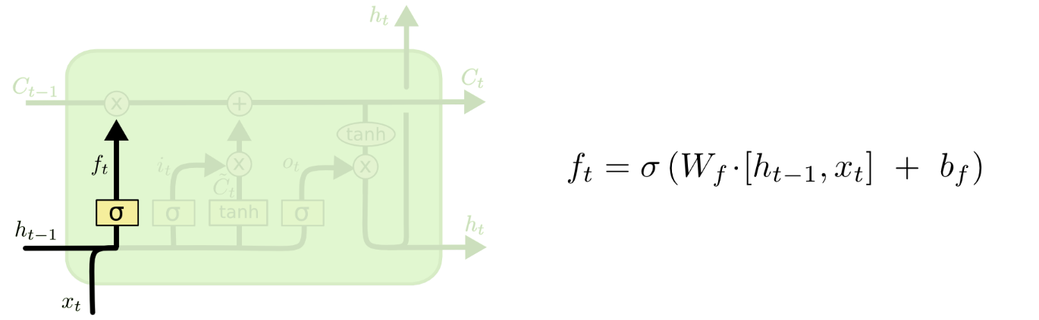
Step-by-Step LSTM Walk Through
Forget gate: The first step in our LSTM is to decide what information we’re going to throw away from the cell state.
When we “see” something new relevant we decide forget….

Slide 52
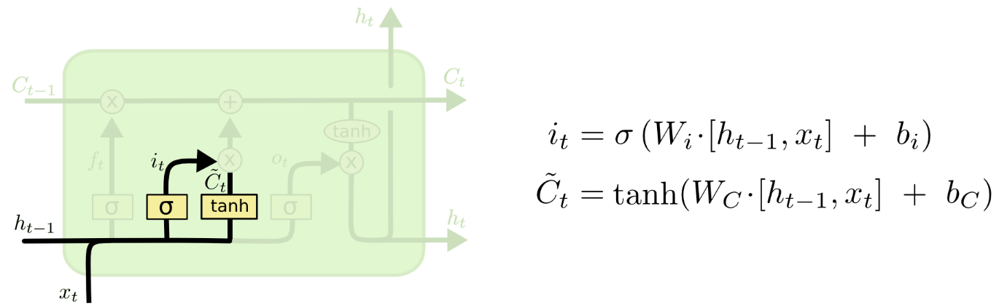
Step-by-Step LSTM Walk Through
The next step is to decide what new information we’re going to store in the cell state. This has two parts.
First, a sigmoid layer called the “input gate layer” decides which values we’ll update.
Next, a tanh layer creates a vector of new candidate values, $\tilde{C_{t}}$, that could be added to the state.

Slide 53
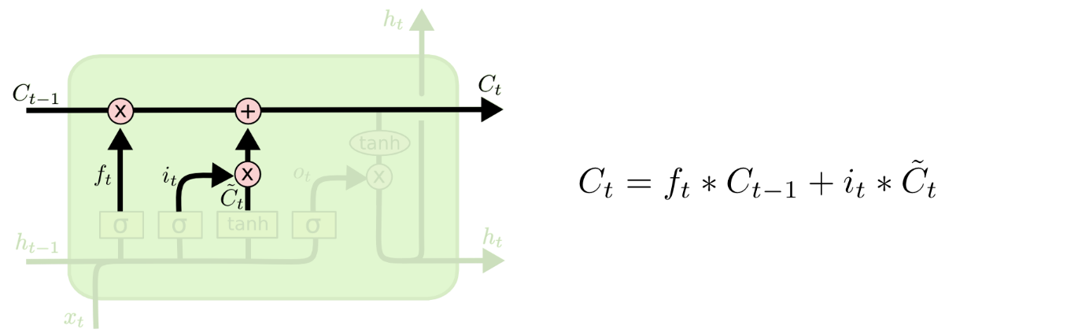
Step-by-Step LSTM Walk Through
It’s now time to update the old cell state,$C_{t−1}$, into the new cell state $C_{t}$
The previous steps already decided what to do, we just need to actually do it.
We multiply the old state by $f_{t}$(forget gate) then we add $i_{t}∗{\tilde{C}}_{t}$

Slide 54
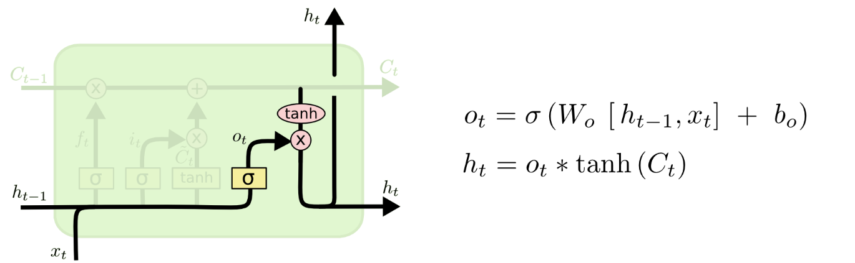
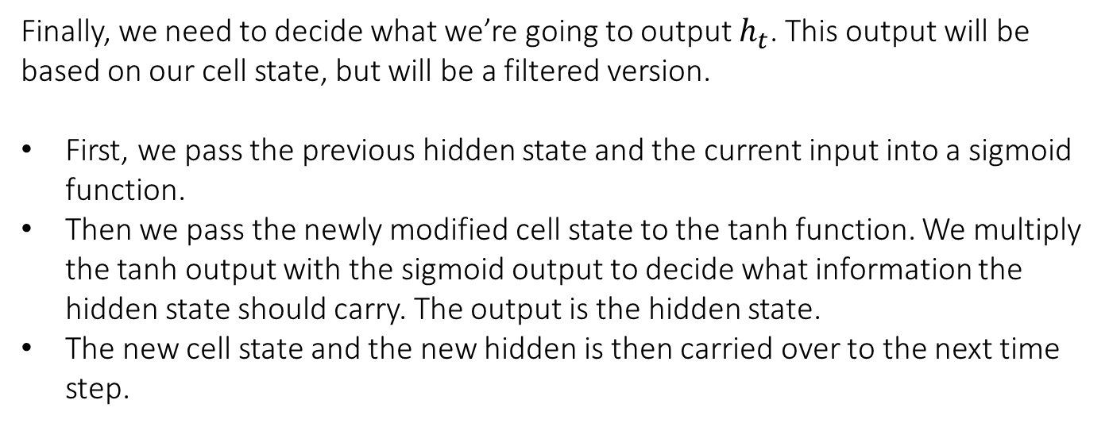
Step-by-Step LSTM Walk Through
Finally, we need to decide what we’re going to output $h_{t}$. This output will be based on our cell state, but will be a filtered version.
First, we pass the previous hidden state and the current input into a sigmoid function.
Then we pass the newly modified cell state to the tanh function. We multiply the tanh output with the sigmoid output to decide what information the hidden state should carry. The output is the hidden state.
The new cell state and the new hidden is then carried over to the next time step.

Slide 55
You can also see:
https://towardsdatascience.com/illustrated-guide-to-lstms-and-gru-s-a-step-by-step-explanation-44e9eb85bf21

Slide 56
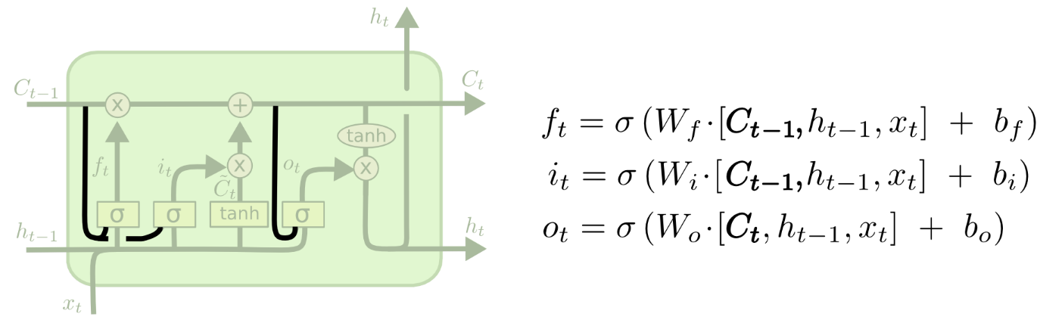
Variants on Long Short Term Memory
One popular LSTM variant, introduced by Gers & Schmidhuber (2000), is adding “peephole connections.”
This means that we let the gate layers look at the cell state.
The above diagram adds peepholes to all the gates, but many papers will give some peepholes and not others.

Slide 57
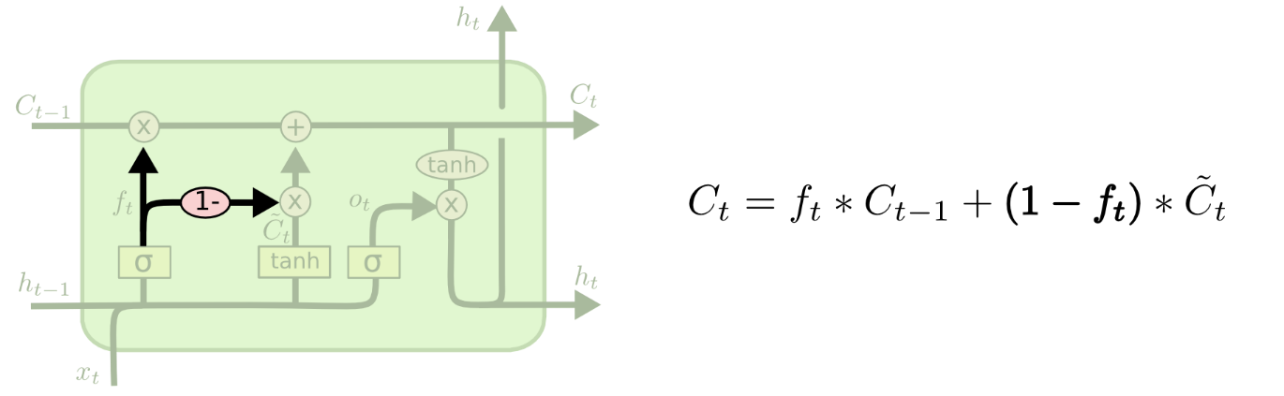
Variants on Long Short Term Memory
Another variation is to use coupled forget and input gates.
We only input new values to the state when we forget something older

Slide 58
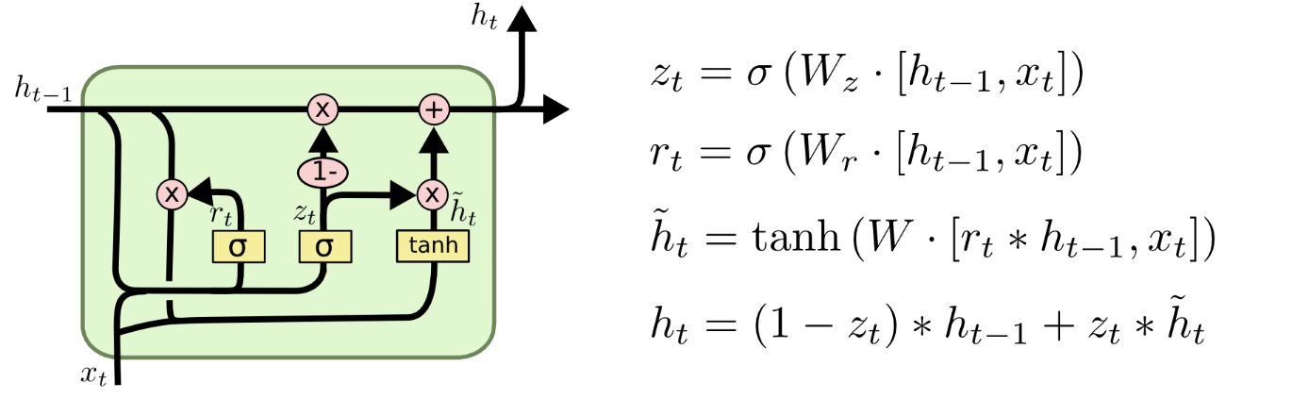
Variants on Long Short Term Memory
Gated Recurrent Unit, or GRU, introduced by Cho, et al. (2014).
It combines the forget and input gates into a single “update gate.”
It also merges the cell state and hidden state, and makes some other changes.
The resulting model is simpler than standard LSTM models, and has been growing increasingly popular.

Slide 59
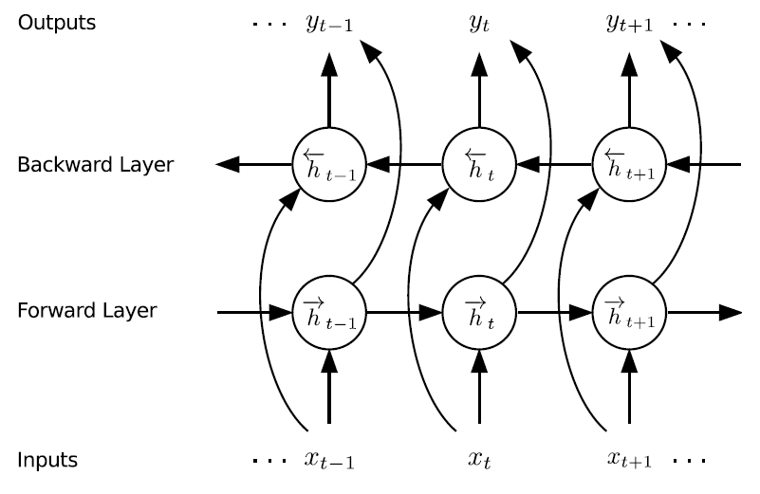
Variants on Long Short Term Memory
These are only a few of the most notable LSTM variants.
See for example: BLSTM Bi-directional LSTM

Slide 60
Variants on Long Short Term Memory
Which of these variants is best? Do the differences matter?
Greff, et al. (2015) do a nice comparison of popular variants, finding that they’re all about the same.
Jozefowicz, et al. (2015) tested more than ten thousand RNN architectures, finding some that worked better than LSTMs on certain tasks.

Slide 61
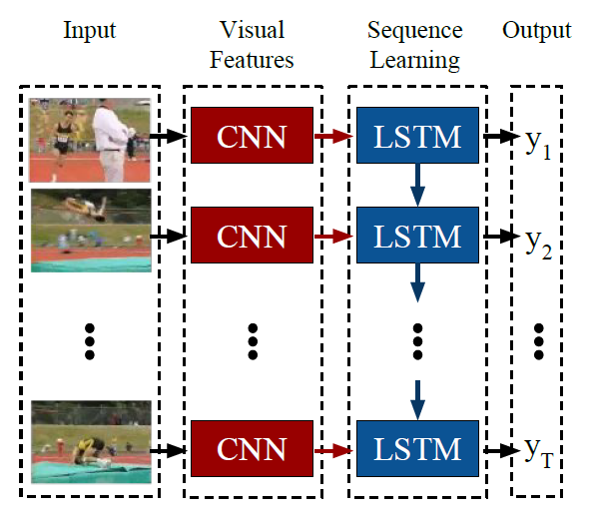
Remember you can combine different DL architectures
…sometimes CNNs are considered as feature extraction after RNN…

Slide 62
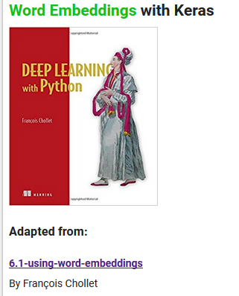
Embedding:
Indices by themselves, carry no semantic meaning
https://github.com/MasterMSTC/DeepLearning_TF_Keras
MSTC_Keras_RNN_3_Word_Embeddings.ipynb

Slide 63
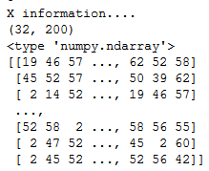
Embedings
Indices by themselves, carry no semantic meaning
This is where embedding comes in; more commonly known as word vector or word embedding.
http://sebastianruder.com/word-embeddings-1/

Slide 64
Embedings
In this case, we will
map the characters to low dimensional vectors of size state_size.
low-dimensional vector
(state_size = n_inputs)
http://sebastianruder.com/word-embeddings-1/

Slide 65
EMBEDDING LAYER
low-dimensional vector
GRU / LSTM
http://stackoverflow.com/questions/40184537/what-does-embedding-do-in-tensorflow

Slide 66
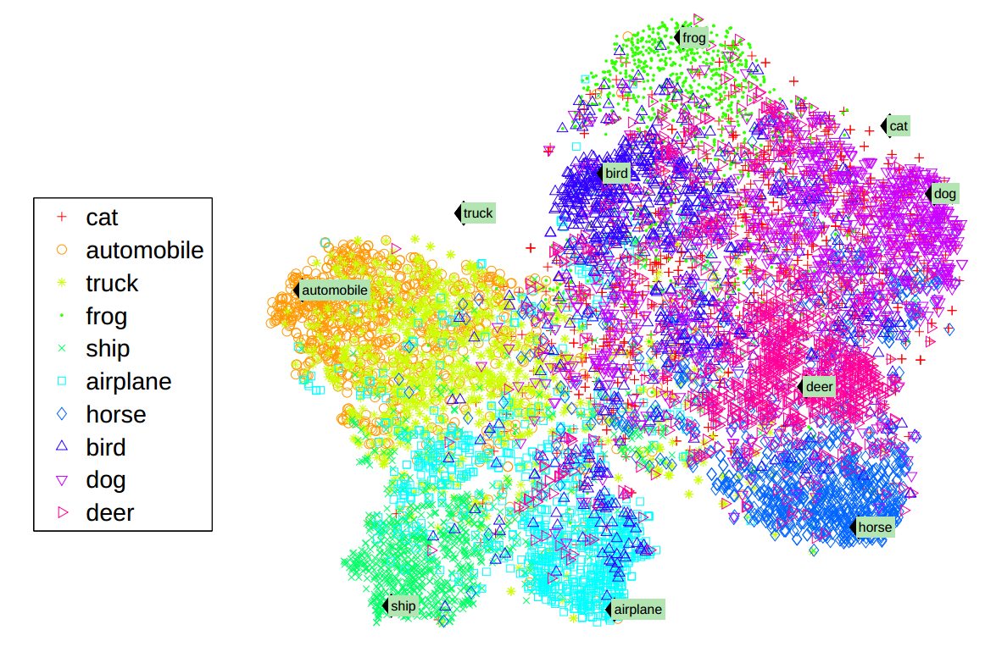
http://colah.github.io/posts/2014-07-NLP-RNNs-Representations/

Slide 67

See also:
Word2vec https://www.tensorflow.org/tutorials/word2vec
Vector space models (VSMs) represent (embed) words in a continuous vector space where semantically similar words are mapped to nearby points ('are embedded nearby each other')

Slide 68
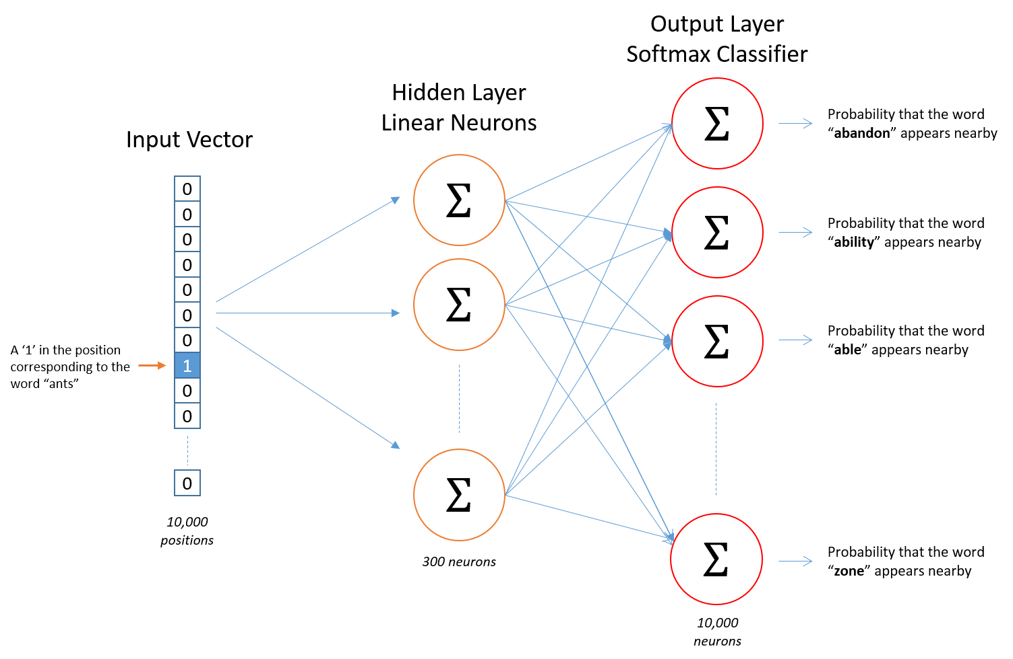
Word2Vec
https://www.youtube.com/watch?v=BD8wPsr_DAI
Sampled
Softmax
OHE

Slide 69
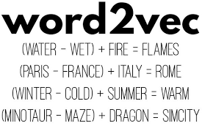
Word2Vec
https://ronxin.github.io/wevi/

Slide 70
You can apply all these ideas to: Modelling MIDI sequences
DLSA_Colab_Music_Generation_LSTM.ipynb

Slide 71
References (I)
https://theneuralperspective.com/2016/10/04/05-recurrent-neural-networks-rnn-part-1-basic-rnn-char-rnn/
http://colah.github.io/posts/2015-08-Understanding-LSTMs/
http://www.wildml.com/2015/09/recurrent-neural-networks-tutorial-part-2-implementing-a-language-model-rnn-with-python-numpy-and-theano/
https://github.com/suriyadeepan/rnn-from-scratch
http://stats.stackexchange.com/questions/241985/understanding-lstm-units-vs-cells
http://monik.in/a-noobs-guide-to-implementing-rnn-lstm-using-tensorflow/
https://medium.com/@erikhallstrm/hello-world-rnn-83cd7105b767
http://suriyadeepan.github.io/2017-01-07-unfolding-rnn/
http://archive.eetindia.co.in/www.eetindia.co.in/VIDEO_DETAILS_700001601.HTM

Slide 72
References (II)
http://r2rt.com/styles-of-truncated-backpropagation.html
http://akkikiki.github.io/assets/LSTM+and+GRU.html
http://campuspress.yale.edu/yw355/deep_learning/
http://datascience.stackexchange.com/questions/12964/what-is-the-meaning-of-the-number-of-units-in-the-lstm-cell
http://stackoverflow.com/questions/37901047/what-is-num-units-in-tensorflow-basiclstmcell

Slide 73
Deep learning basics
https://github.com/lexfridman/mit-deep-learning/blob/master/tutorial_deep_learning_basics/deep_learning_basics.ipynb

Slide 74
GANS
AUTOENCODERS

Slide 75
ETHICS ML
Deep Fakes

Slide 76
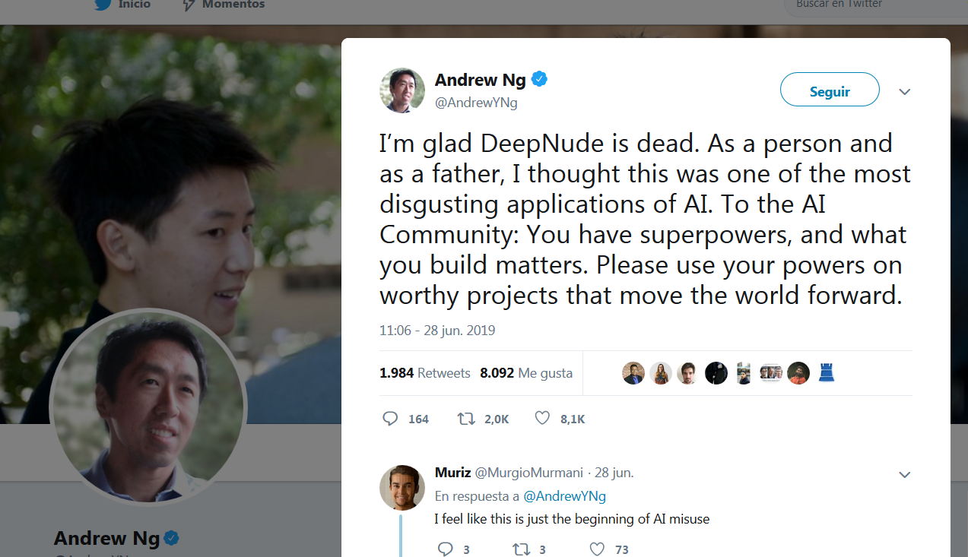

Slide 77
That’s all !
I hope this seminar will be useful to you
…we keep waiting for your amazing deep-applications..
THANK YOU!
luisalfonso.hernandez@upm.es

